Slide 1

PRESENTATION
ON
AGRICULTURAL FINANCE
& CO-OPERATION
LECTURE PREPARED BY -
Dr. J P Singh
Associate Professor
(SGRRU, Dehradun )
DEPARTMENT of AGRICULTURE
SHRI GURU RAMRAI UNIVERSITY, DEHRADUN UTTARAKHAND

Slide 2
Outline
Co-operation meaning scope
Importance and definition
Principles objection of cooperation

Slide 3
Co-operation
Meaning-
According to Huber Calvert “ Co-operation is a form of organization where in persons voluntarily associate together on the basis of equality for the promotion of common economic interest of themselves”.
As per Sir Horace Plunkett co-operation is self help made effective by organization.
Motto of co-operation “Each for all and all for each”

Slide 4
Principles of Co-operation
Principle of open and voluntary association
Principle of democratic organization
Principle of service
Principle of self help and mutual help
Principle of honorary service
Principle of distribution of profits and surpluses
Principle of political and religious neutrality
Principle of education
Principle of thrift
Principle of publicity

Slide 5
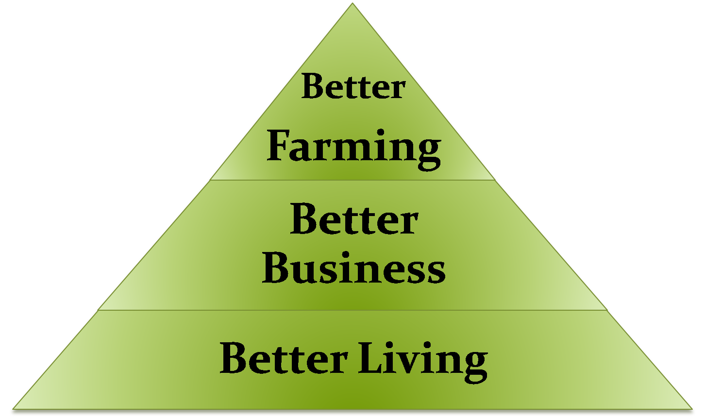
Maxims of co-operation

Slide 6
Thank you
Prepared By -
Dr. J P SINGH
ASSOCIATE PROFESSOR
DEPARTMENT OF AGRICULTURE AND AGRONOMY

